Slide 1

INFO-6150 Final Project
Tipton Hotel
(Hotel Management System)
Seona Rodrigues - 002760607
Neha Joisher - 002768975
Freya Dsouza - 002756302
Kartik Sunil - 002910070

Slide 2
Purpose
Tipton Hotel website is a one stop solution to engage users with better hospitality experience.
This application will allow users to book a room, order food online , and reserve a seat for Dine In Restaurant.
Users can also request to reserve a hall for special occasions.

Slide 3
Functionality
Register and Login
Authentication
CRUD operation on application
Book a room
Order Food
Payment Gateway
Generate Reports
User-friendly

Slide 4
API Implemented
Encrypted Passwords using Bycrpt
Json Web Token for authentication
Mongoose to interact with MongoDB
Axios to provide connection between browser and client.

Slide 5
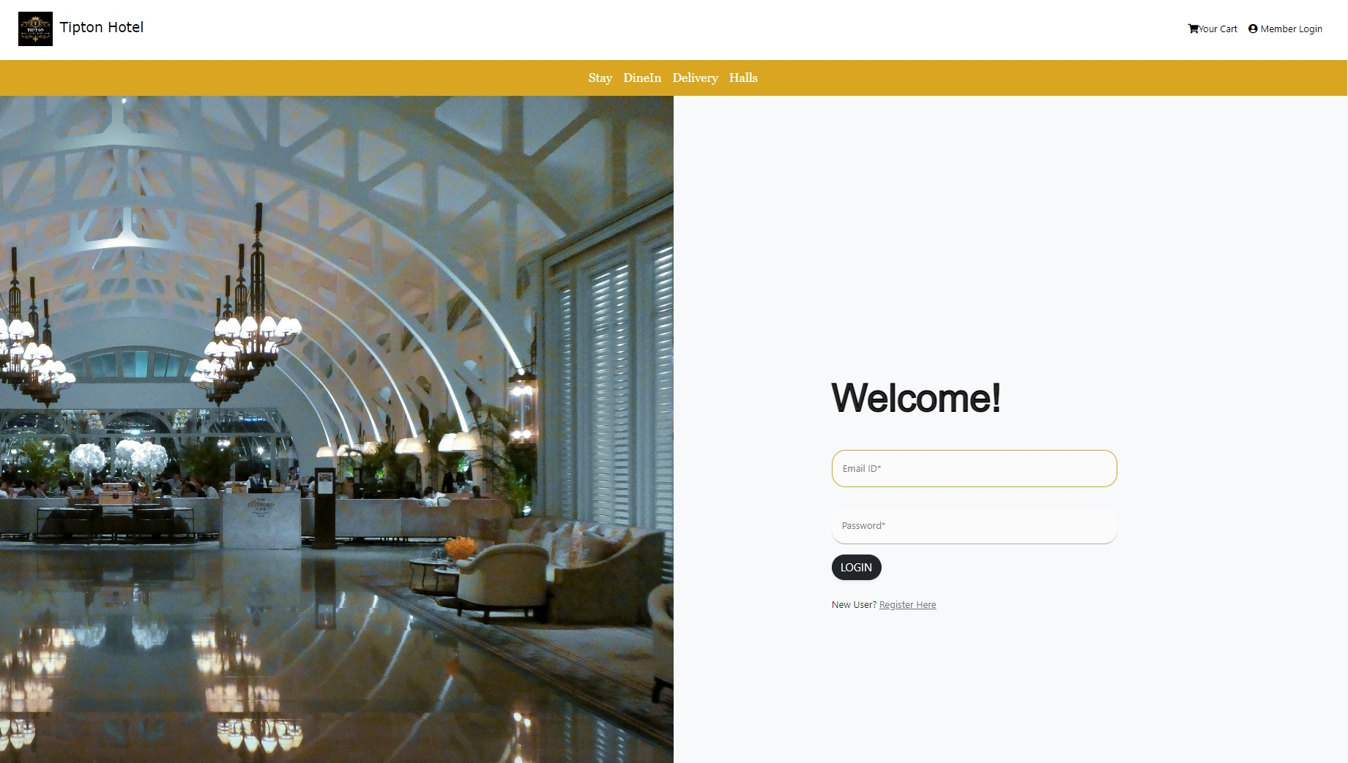
Login Page

Slide 6
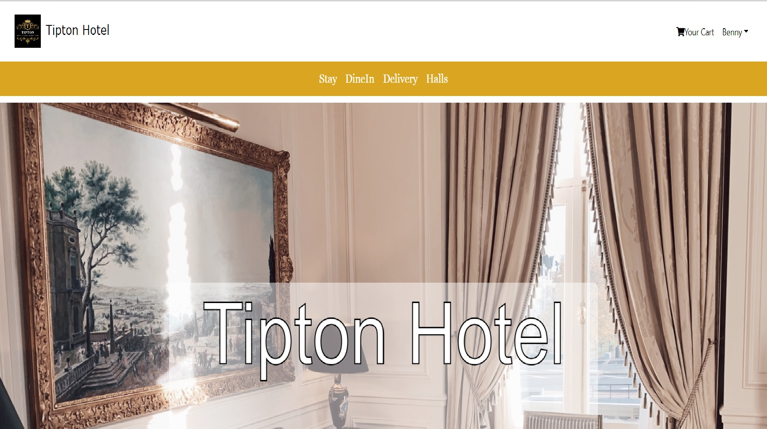
Home Page

Slide 7
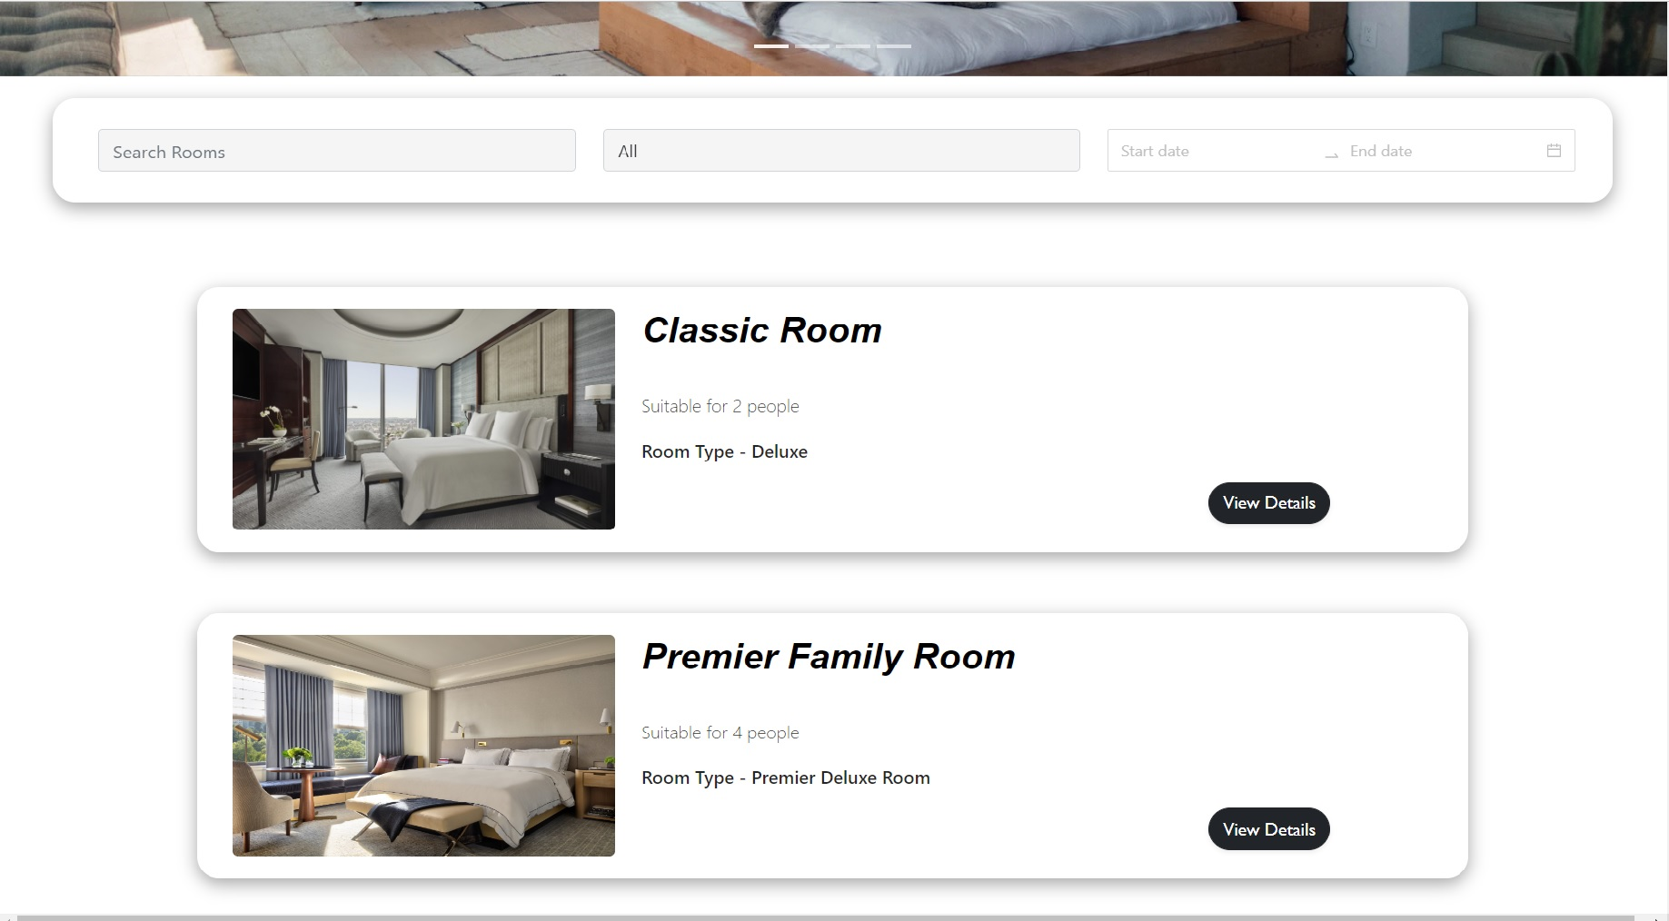
Room Listing

Slide 8
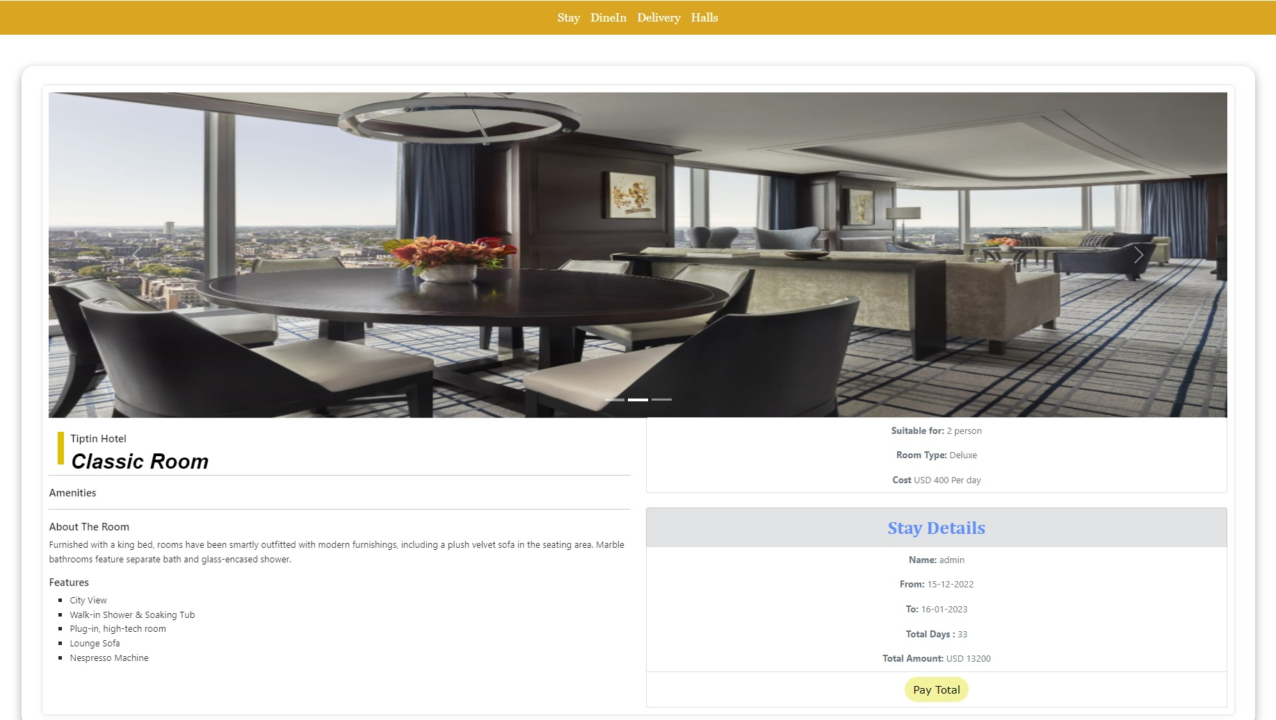
Payment Gateway

Slide 9
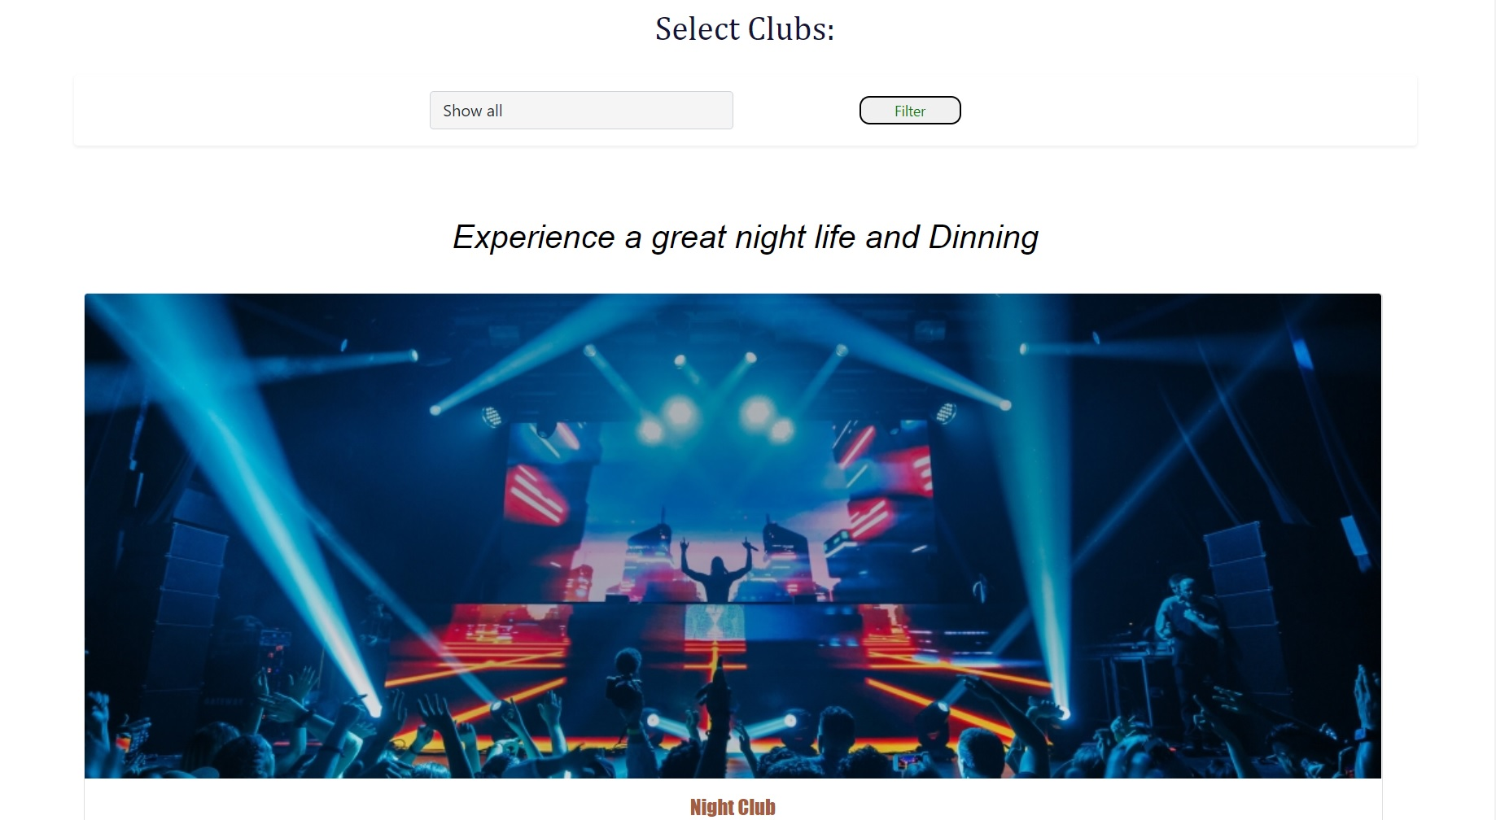
Dine In Page

Slide 10
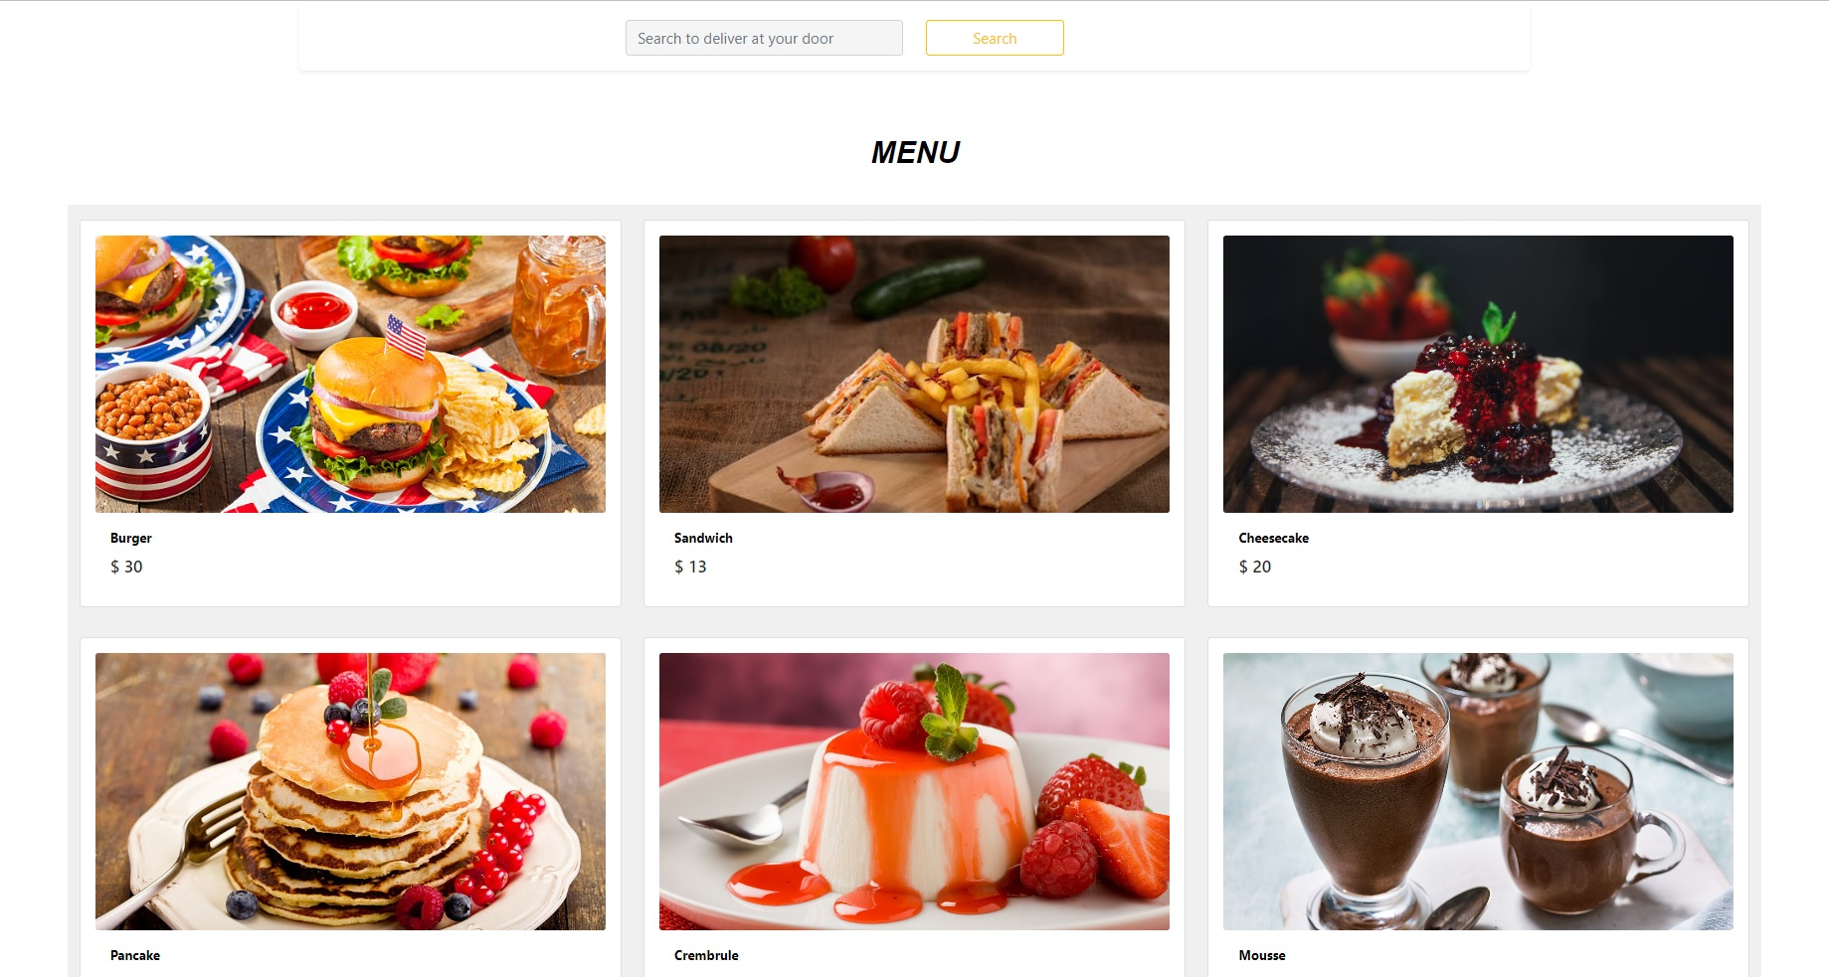
Food Delivery

Slide 11
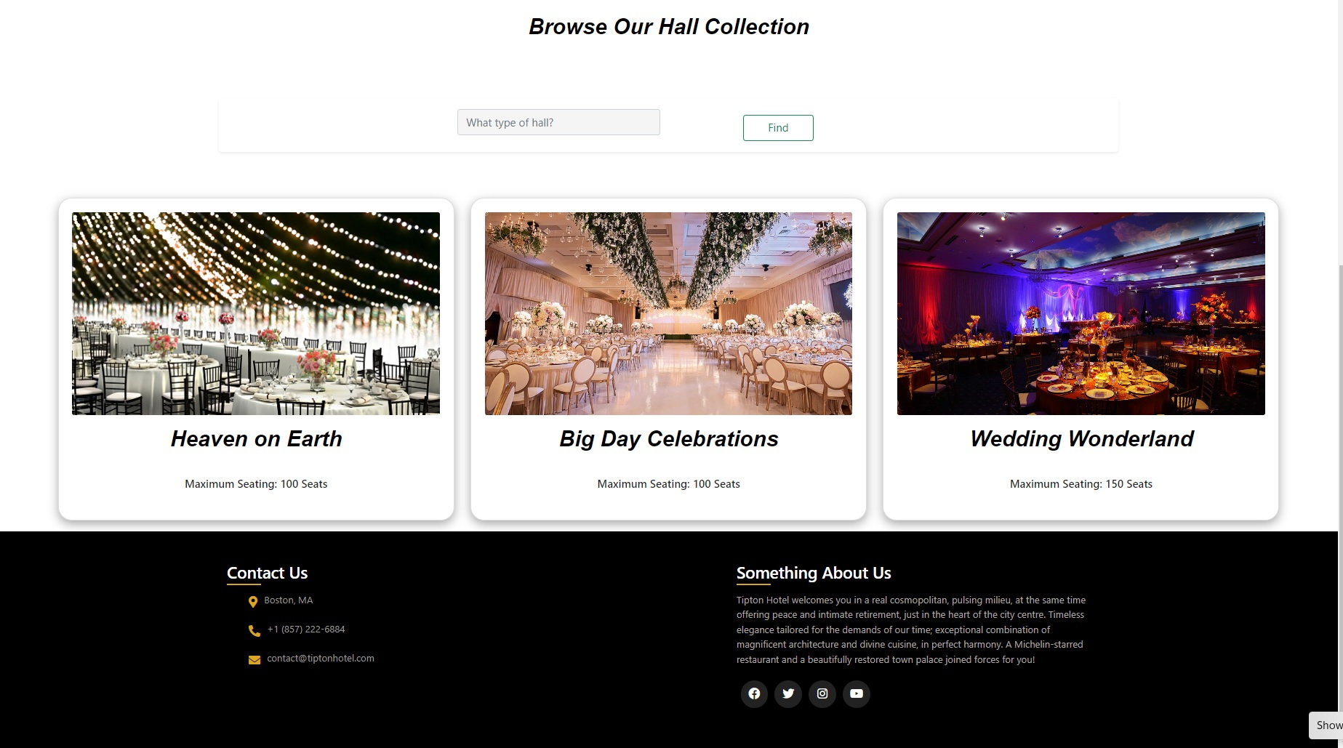
Hall Listing

Slide 12
References
https://www.mongodb.com/
https://jwt.io/
https://www.npmjs.com/package/mongoose
https://www.mongodb.com/
https://reactjs.org/
https://expressjs.com/

Slide 13
Thank you

